Slide 1
DIGITAL SIGNATURES and AUTHENTICATION PROTOCOLS
- Chapter 13
Digital Signatures
Authentication Protocols
Digital Signature Standard

Slide 2
AUTHENTICATION vs
SIGNATURE
Authentication
_{auth}
A → B
protects against{C}
Signature
_{sign}
A → B
protects against{A,C}

Slide 3
SIGNATURE
CHARACTERISTICS
Author Verifiable
Date Authenticate by
Time Contents Third
Party

Slide 4
SIGNATURE
TYPES
Direct
X → Y
weakness: security of private key
Arbitrated
_{+ date}
X → A → Y

Slide 5
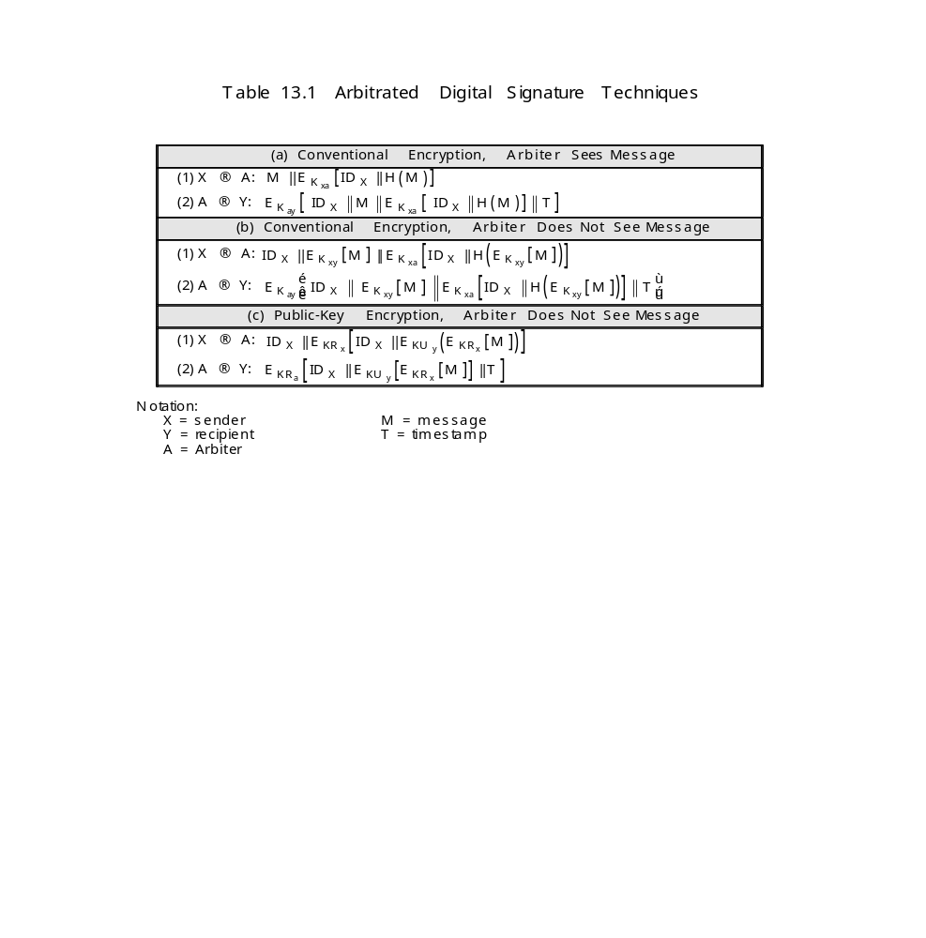
ARBITRATED DIGITAL
SIGNATURE TECHNIQUES

Slide 6
Table 13.1: Scheme (a)
Arbiter Sees Message
Conventional Encryption:
After X → A → Y
Dispute between X and Y
Y → A: E_{Kay}[ID_{x}||M||E_{Kax}[ID_{x}||H(M)]]

Slide 7
Table 13.1: Scheme (b)
Arbiter Does Not See Message
Conventional Encryption:
Arbiter
: neither can read message
Eavesdropper

Slide 8
Table 13.1: Scheme (c)
Arbiter Does Not See Message
Public-Key (double) Encryption:
advantages:
1. No information shared before communication
2. if KRx compromised
date is still correct
3. message secret from Arbiter and Eavesdropper

Slide 9
REPLAY ATTACKS
Simple Replay: X →m
E →m
Logged Replay: X →m||T₀ t
E →m||T₀ (< T₀ later) i
m
Undetected Replay:X →m e
E →m →
Backward Replay: X →m
X ←m E

Slide 10
TIMESTAMP
_{m||T}
X Y
synchronized clocks

Slide 11
CHALLENGE/RESPONSE
Use NONCE:
_{N}
X Y
_{m||N}
X Y
handshake required

Slide 12
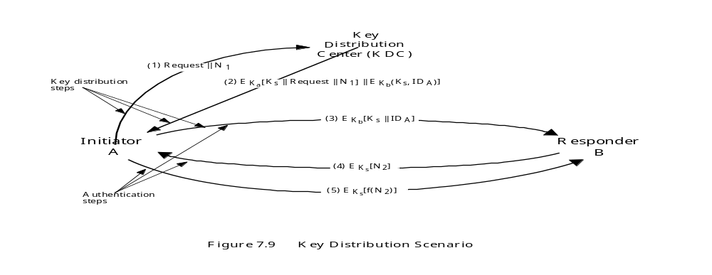
ATTACK ON Fig 7.9
E avesdropper gets Old K_{s}:
Replay Step 3
Intercept Step 4
Impersonate Step 5
Bogus Messages → Y

Slide 13
SOLUTION: TIMESTAMP
A →ID_{A}||ID_{B} KDC
2. KDC →E_{KA}[ K_{S}||ID_{B}||T||E_{KB}[K_{S}||ID_{A}||T] ] A
3. A →E_{KB}[K_{S}||ID_{A}||T] B
4. B →E_{KS}[N₁] A
5. A →E_{KS}[f(N₁)] B

Slide 14
CLOCK ATTACKS
To counteract: Suppress – Replay attacks:
1. Check clocks regularly
use KDC clock
2. Handshaking via Nonce

Slide 15
AN IMPROVED PROTOCOL over Fig 7.9
To counteract suppress-replay attacks:
A →ID_{A}|| N_{A} B
B →ID_{B}||N_{B}||E_{KB}[ID_{A}||N_{A}||T_{B}] KDC
KDC
→E_{KA}[ID_{B}||N_{A}||K_{S}||T_{B}]||E_{KB}[ID_{A}||K_{S}||T_{B}]||N_{B}
A
A →E_{KB}[ID_{A}||K_{S}||T_{B}]||E_{KS}[N_{B}] B
No clock synch.
T_{B} only checked by B

Slide 16
AUTHENTICATION SERVER
- no secret key distribution (public key)
A →ID_{A}||ID_{B} AS
AS →E_{KRAS}[ID_{A}||KU_{A}||T]||E_{KRAS}[ID_{B}||KU_{B}||T] A
3. A →E_{KRAS}[ID_{A}||KU_{A}||T]||E_{KRAS}[ID_{B}||KU_{B}||T]||E_{KUB}[E_{KRA}[K_{S}||T]]
B
Problem: Clock Synch.

Slide 17
ALTERNATIVE NONCE
PROTOCOL
1. A →ID_{A}||ID_{B} KDC
2. KDC →E_{KRauth}[ID_{B}||KU_{B}] A
3. A →E_{KUB}[N_{A}||ID_{A}] B
4. B →ID_{B}||ID_{A}||E_{KUauth}[N_{A}] KDC
5. KDC →E_{KRauth}[ID_{A}||KU_{A}]||E_{KUB}[E_{KRauth}[N_{A}||K_{S}||ID_{A}||ID_{B}]] B
6. B →E_{KUA}[E_{KRauth}[N_{A}||K_{S}||ID_{A}||ID_{B}]||N_{B}] A
7. A →E_{KS}[N_{B}] B

Slide 18
ONE-WAY
AUTHENTICATION
(e.g. email)
Encrypt Message
Authenticate Sender

Slide 19
SYMMETRIC-KEY
(one-way auth.)
A →ID_{A}||ID_{B}||N₁ KDC
KDC →E_{KA}[K_{S}||ID_{B}||N₁||E_{KB}[K_{S}||ID_{A}]] A
3. A →E_{KB}[K_{S},ID_{A}]||E_{KS}[M] B

Slide 20
PUBLIC-KEY
(one-way auth.)
Use Figs 11.1b,c, and d
or
A →E_{KUB}[K_{S}]||E_{KS}[M] B
or
A →M||E_{KRA}[H(M)] B

Slide 21
PUBLIC-KEY
(one-way auth.)
Send A’s public key to B
A →M||E_{KRA}[H(M)]||E_{KRAS}[T||ID_{A}||KU_{A}] B

Slide 22
DSS : USES SHA-1
Signature YES
Encryption NO
Key-Exchange NO

Slide 23
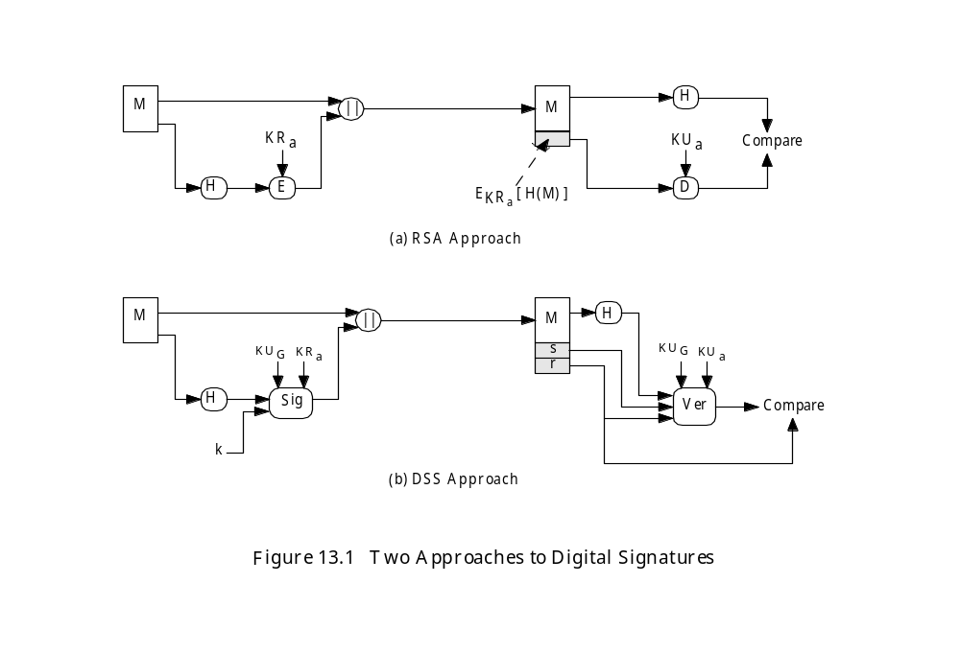
DSS : USES SHA-1

Slide 24
DISCRETE LOG
p,q,g – global public keys
x - user private key
y - user public key
k - user per-message secret number
r = (g^{k} mod p) mod q
s = [k⁻¹(H(M) + xr)] mod q
Signature = (r,s)
precompute g^{k}, k⁻¹

Slide 25
VERIFY
w = (s’)⁻¹ mod q
u₁ = [H(M’)w] mod q
u₂ = (r’)w mod q
v = [(g^{u1}.y^{u2}) mod p] mod q
where y = g^{x} mod p
v = r’ ?
y = g^{x} is one-way:
x → y YES
y → x NO

Slide 26
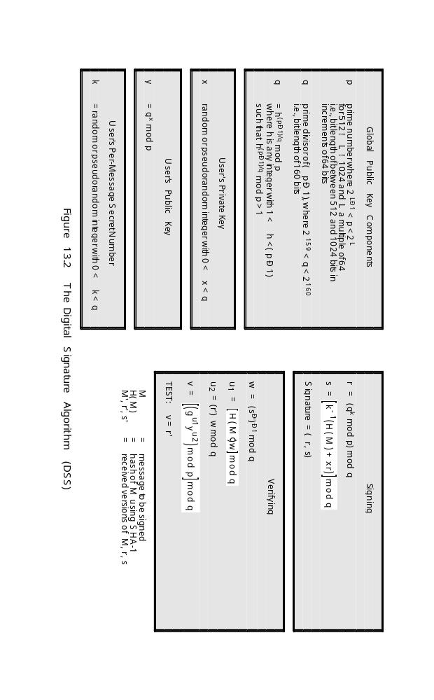
DIGITAL SIGNATURE ALGORITHM

Slide 27
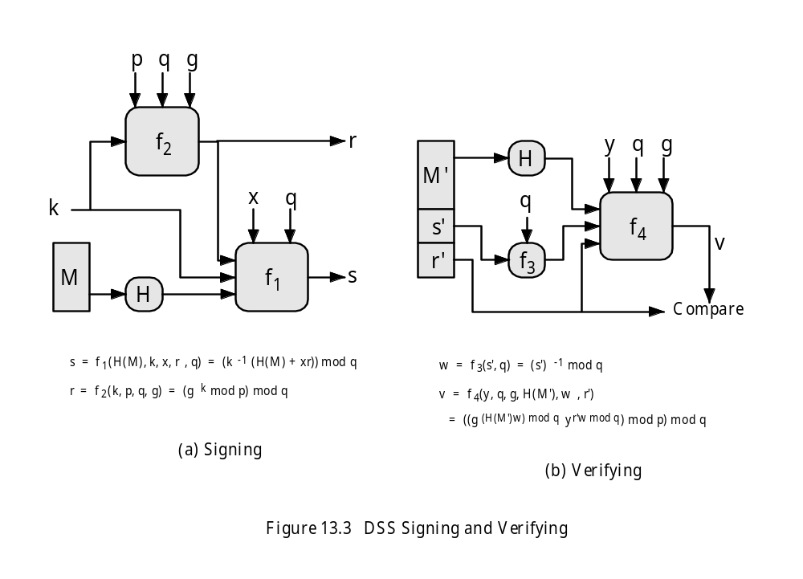
DSS SIGNING AND VERIFYING

